Slide 1
Renewable Sources of Energy: Distributed Energy Generation & Waste to Energy Power Plants in Los Angeles County
By Hugo Sarmiento
UP 206A

Slide 2
What is Distributed Energy?
Distributed energy resources are small-scale power generation technologies located close to where electricity is used (e.g., a home or business) to provide an alternative to or an enhancement of the traditional electric power system.

Slide 3
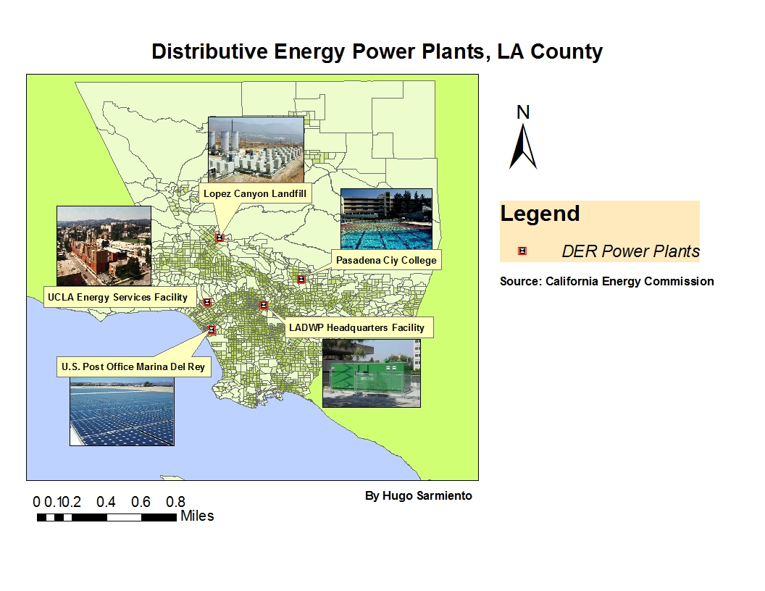

Slide 4
What is Waste to Energy?
Waste to Energy Power Plants create energy from incinerating waste source (typically from landfills). It is a form of energy recovery.
WTE Power Plants provide the additional benefit of reducing biomethane gas levels produced by landfills.

Slide 5
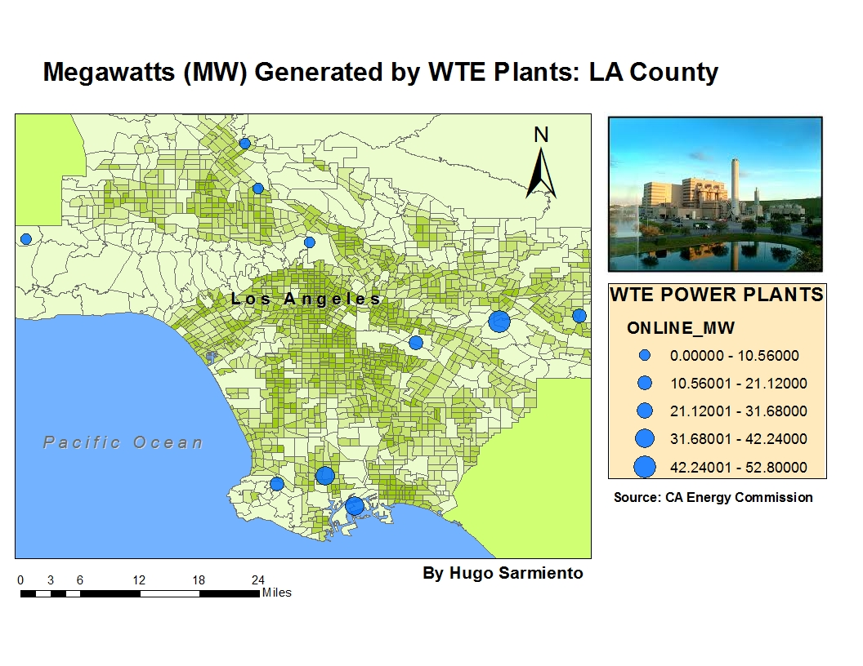

Slide 6
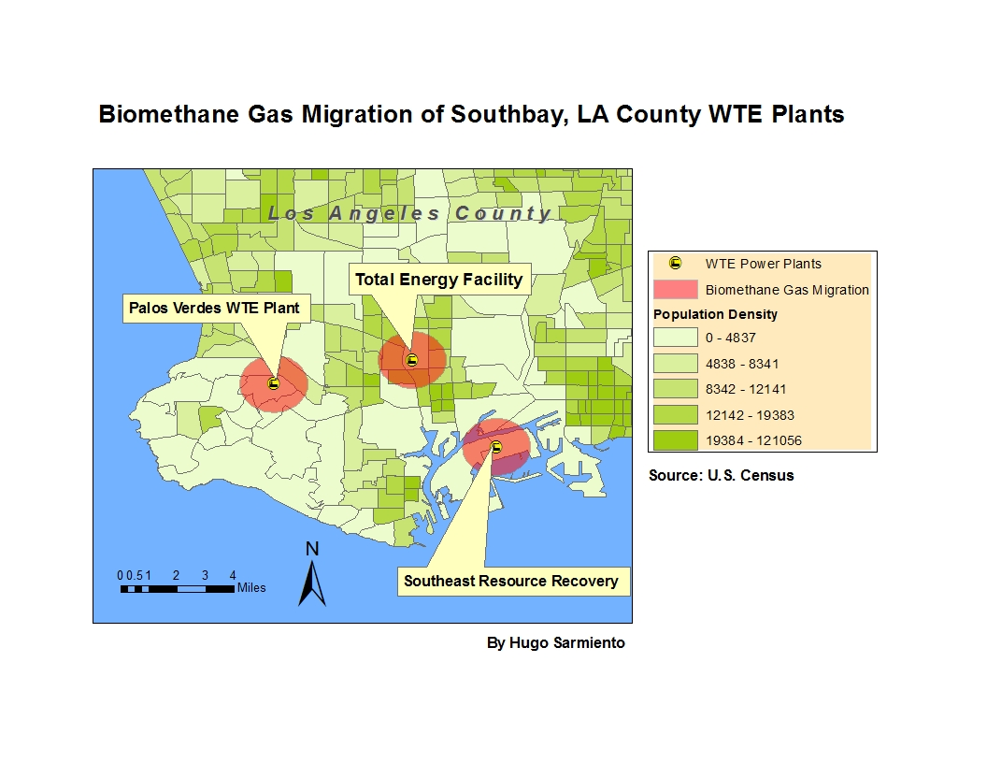

Slide 7
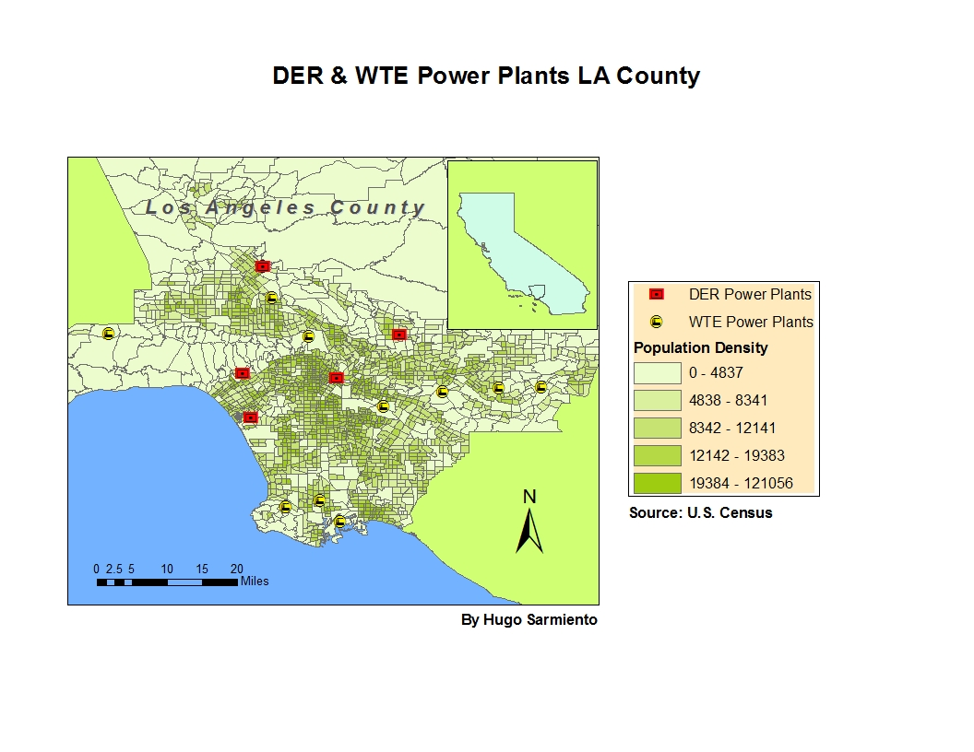

Slide 8
Skills Used
Geoprocessing (slides 3,5,6&7)
Geocoding (slides 3&5)
Buffering (slide 6)
Graduated Point Symbol (slide 5)
Inset Map (slide 7)
Inserted Pictures/ Images (slide 3)

