Slide 1
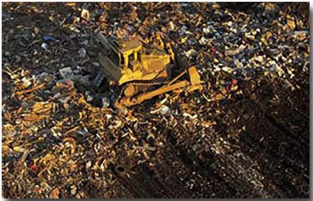
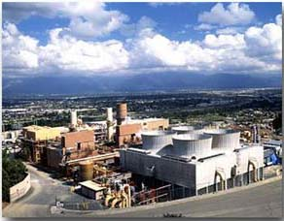
Potential for Waste To Energy (WTE) Power Plants in Los Angeles County
Hugo Sarmiento
UP 206A

Slide 2
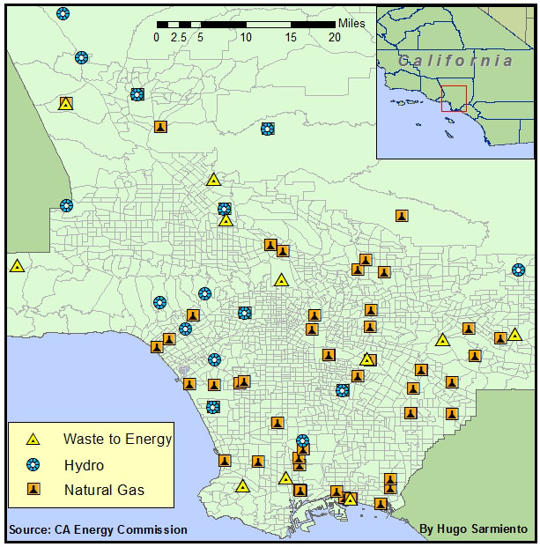
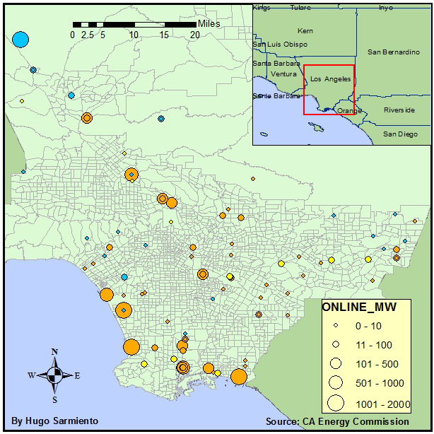
Power Plants in LA County
Megawatts (MW) Generated
Number of Power Plants
Waste To Energy | 12
Hydro | 28
Natural Gas | 89

Slide 3
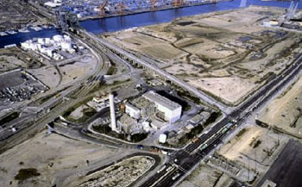
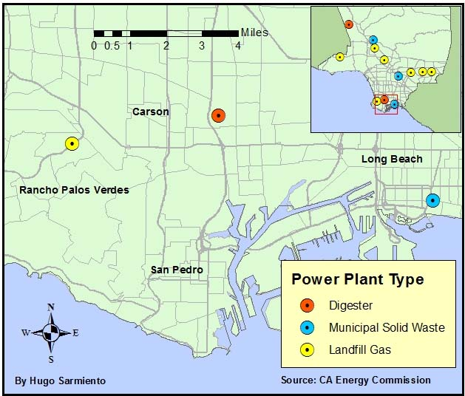
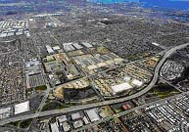
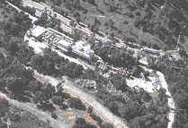
Total Energy Facility
Digester facilities are fueled with biogas produced from organic wastes such as food processing waste.
Palos Verdes Energy Recovery Facility
South East Resource Recovery Facility
Municipal Solid Waste can be directly combusted in waste-to-energy facilities as a fuel with minimal processing, known as mass burn.
These facilities are fueled with landfill gas generated by the natural degradation of waste by anaerobic micro-organisms.

Slide 4
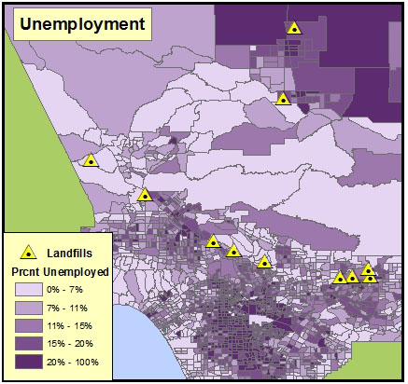
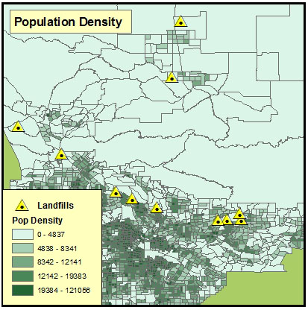
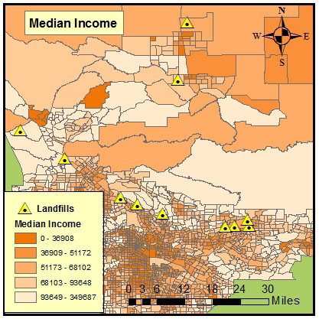
Landfills and Population Characteristics in Los Angeles County

Slide 5
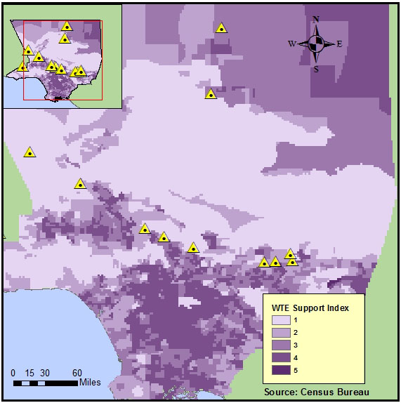
Hot Spot Analysis: Potential Support for Waste-to-Energy Plants

Slide 6
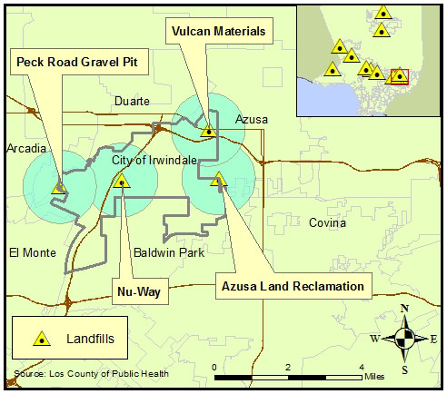
Communities Likely to Support Waste-to-Energy Campaigns

Slide 7
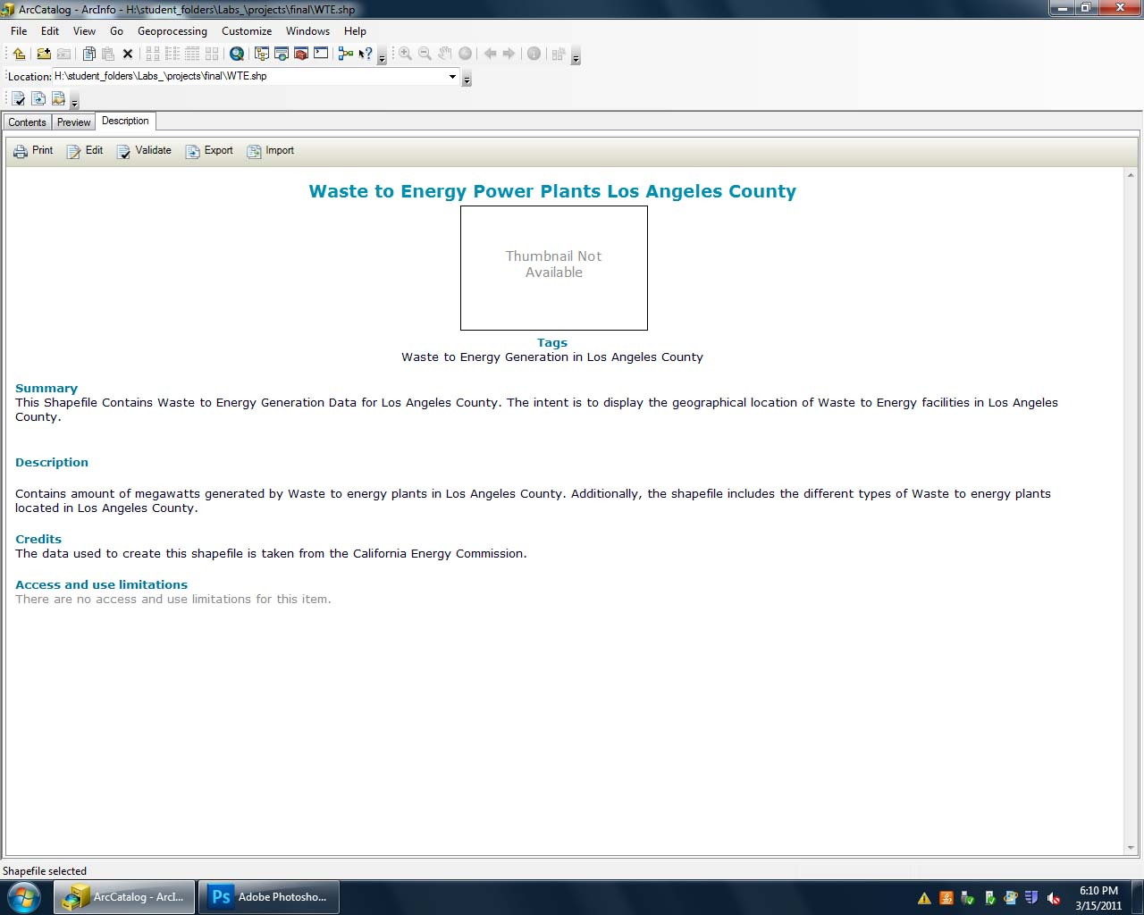

Slide 8
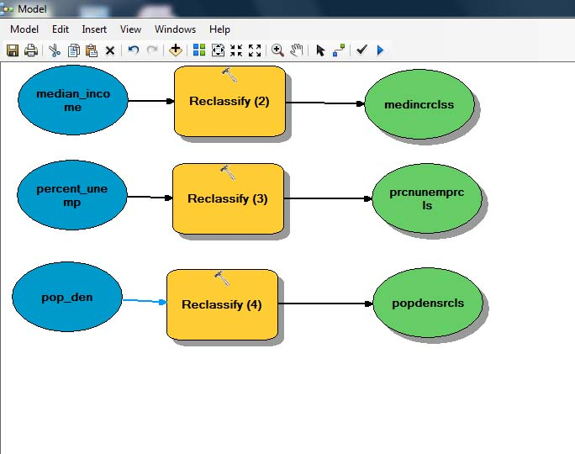

Slide 9
GIS Skills Used
Geoprocessing
Geocoding
Inset Map
Buffering
Select by Attribute
Modeling
Metadata
Hotspot Analysis
Graduated Symbols
Use of Charts and Images

